Slide 1

Our Robot Car Azza
Table of contents
01
03
Introduction
Project algorithm
04
06
Hardware component
Our team
IoT Project
02
Problem statement
05
Software parts

Slide 2
Our Robot Car Azza
Table of contents
01
03
Introduction
Project algorithm
04
06
IoT Project
Our team
Hardware component
02
Problem statement
05
Software parts

Slide 3
Table of contents
01
02
03
Problem statement
Introduction
Project algorithm
04
05
06
Hardware component
Software parts
Our team
Introduction

Slide 4
Introduction

Slide 5
- The major goal of our study is to detect flames by regulating vehicle motion.
- Additionally, the vehicle features a manual mode that can be operated using gestures on a controller.

Slide 6
More Ideas and Uses
Robot Arm Car
Sensors
Problem Statement
An arm can be added to the robot car that can be multifunctional robot
More sensors can be added to increase its role as temperature, camera and controlling speed sensor

Slide 7
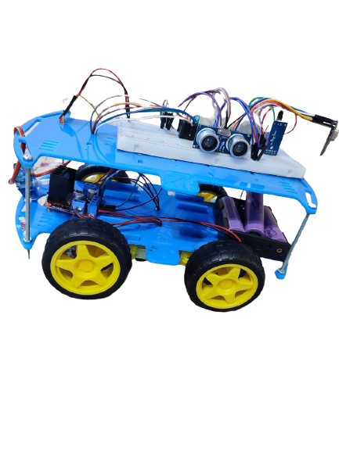
Problem Statement

Slide 8
We used two techniques
After supplying the vehicle with voltage
» we turn the remote on and enter the password
» Open flutter application and sign in into the car

Slide 9
We used two techniques
Flutter application
Remote control
We can drive the car with buttons in the flutter application, and it also displays sensor readings.
A remote control that controls the car by using hand gestures.

Slide 10
Remote control
Remote control
Flutter application
There are two modes on the remote control:
- First one: The car will drive straight and avoid any adjacent objects by using an ultrasonic sensor to calculate distance.
- Second one: The car moves manually by angling the controller in the desired direction.
A Remote that controls the car by moving the controller with hand gestures
We can drive the car with buttons in the flutter application, and it also displays sensor readings.

Slide 11
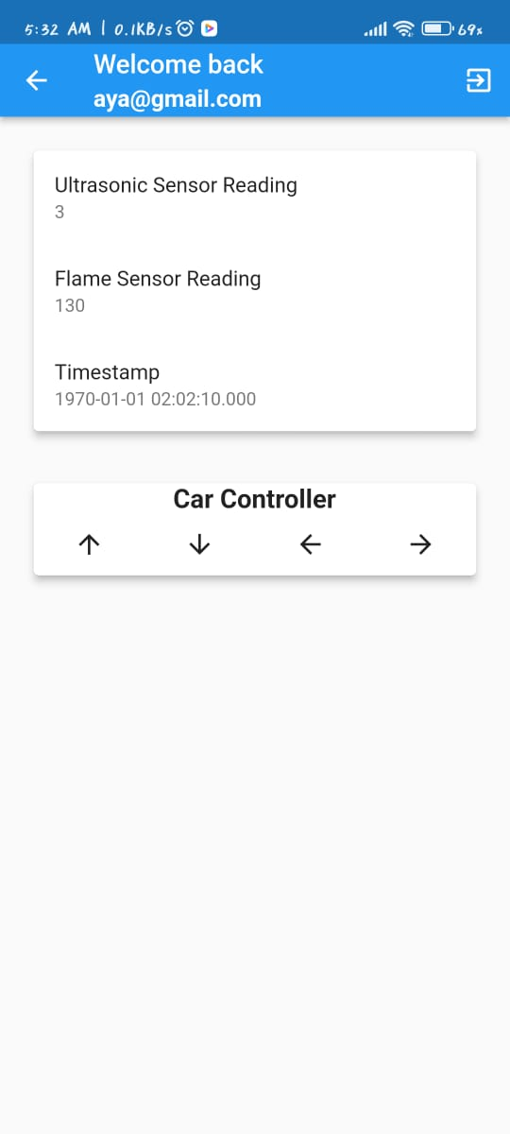
Flutter application
Remote control
A remote control that controls the car by using hand gestures.

Slide 12
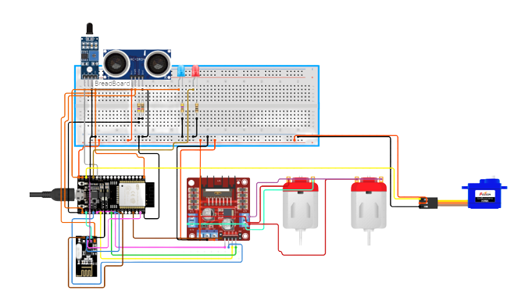
Project Algorithm
Azza’s Design

Slide 13
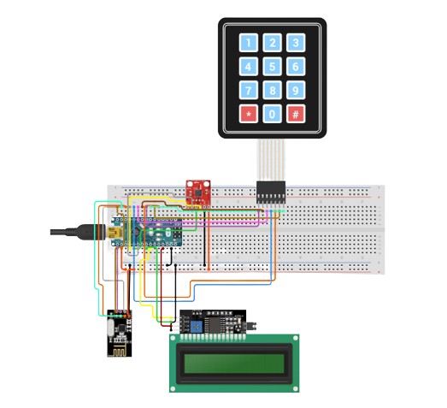
Azza’s Design
Controller Design

Slide 14
Controller Design

Slide 15
Hardware component
Hardware component
1. Motor Driver
3. Flame sensor
4. NRF Module
6. Keypad & LCD
2. Servo motor & Ultrasonic sensor
5. ADXL 335 Accelerometer

Slide 16
Hardware component
1. Motor Driver
2. Servo motor & Ultrasonic sensor
3. Flame sensor
5. ADXL 335 Accelerometer
4. 2 NRF Module
6. Keypad & LCD

Slide 17
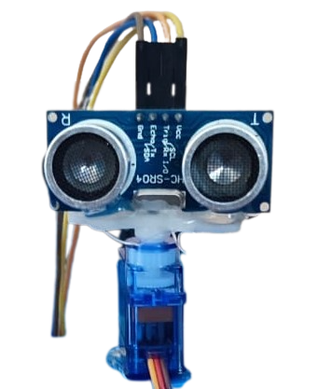
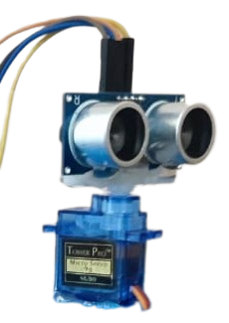
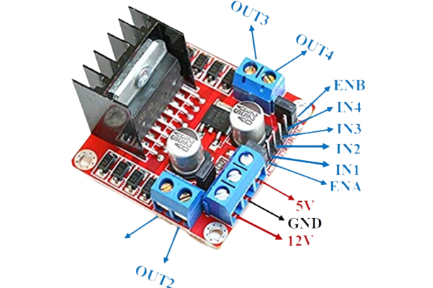
Stage 2:
This component serves as a radar to deliver a warning if an object is detected within a 20 cm range around the car.
2. Servo motor & Ultrasonic Sensor
1. Motor Driver
- The car is moved first by the motor driver, which directs the flow of current from the parts in and out and controls the power entering the motor.
- The motor driver requires up to 12 volts to move, common ground, and the ESP32 requires 5 volts to connect to it and regulate the motor's direction.

Slide 18
2. Servo motor & Ultrasonic Sensor
This component functions as a radar, alerting the car if an object is detected within a 20-cm radius of the vehicle.
The function of servo motor to be able to detect several sides
Motor Driver
1. Motor Driver
- The car is moved first by the motor driver, which directs the flow of current from the parts in and out and controls the power entering the motor.
- The motor driver requires up to 12 volts to move, common ground, and the ESP32 requires 5 volts to connect to it and regulate the motor's direction.

Slide 19
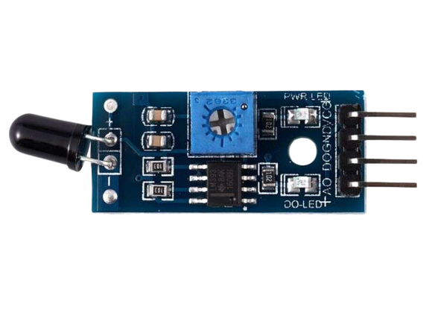
3. Flame Sensor
The primary function of a flame sensor is to detect the presence of a flame or fire. It does this by sensing the specific electromagnetic radiation (usually in the infrared or ultraviolet spectrum) emitted by an open flame. Flames emit characteristic light patterns in these spectra, and the flame sensor is designed to recognize these patterns.

Slide 20
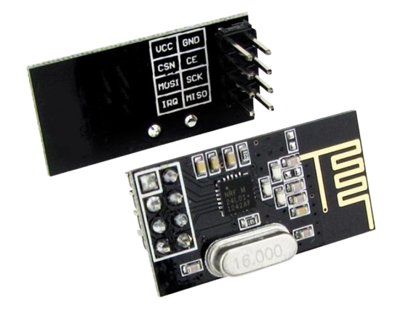
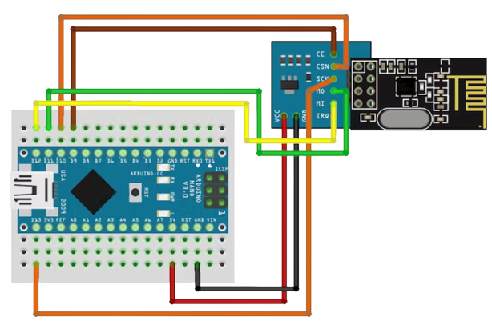
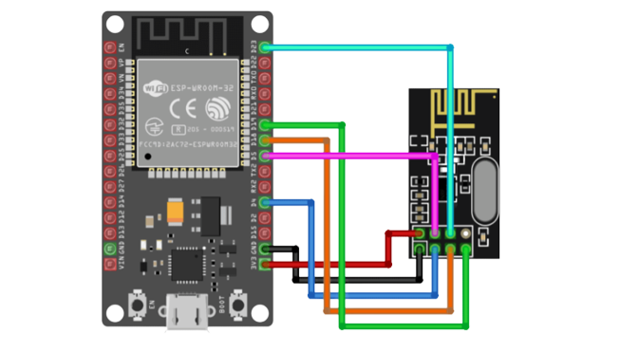
4. NRF Module
NRF Module is the most important part in the project as it is responsible for transmitting the signal to the car and without that signal the car cannot move

Slide 21
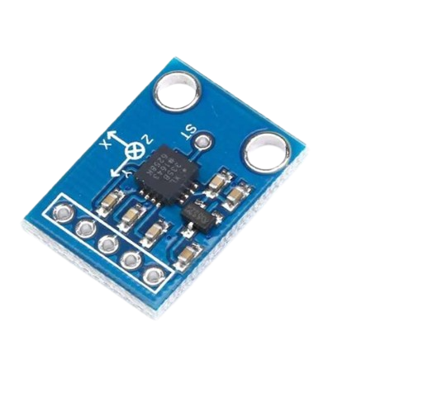
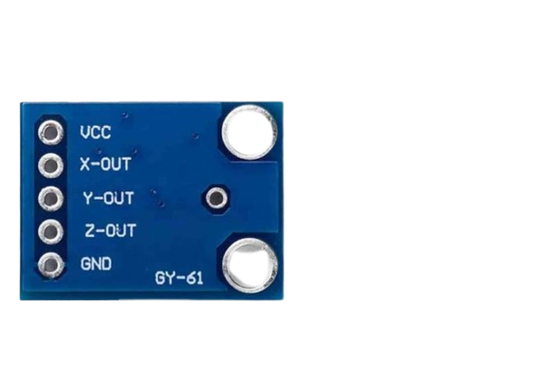
5. ADXL 335
Accelerometer
The ADXL335 is a popular analog accelerometer sensor produced by Analog Devices. It is designed to measure acceleration in three axes (X, Y, and Z)
The ADXL335 accelerometer works based on the principle of measuring the capacitance changes within tiny MEMS (Micro-Electro-Mechanical Systems) structures when subjected to acceleration. When the sensor experiences acceleration, the MEMS structures move, causing a change in capacitance, which is then converted into an analog voltage proportional to the acceleration.

Slide 22
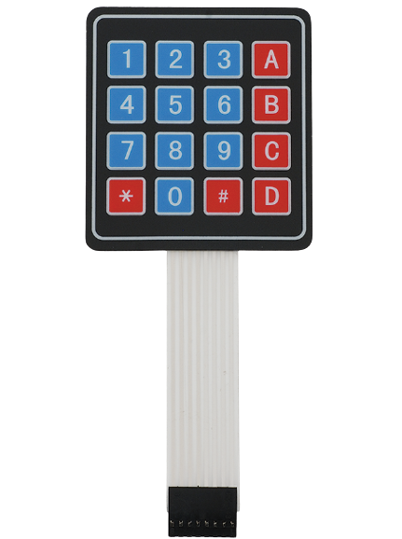
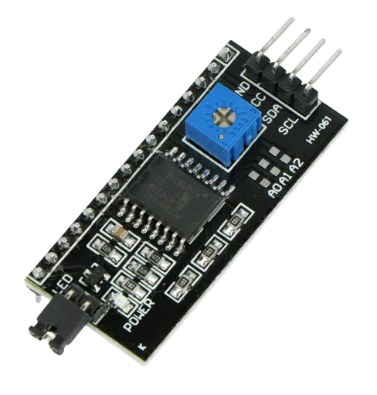
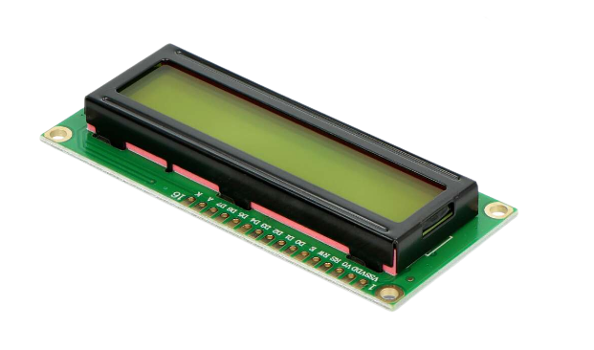
6. Keypad & LCD
The keypad is an input module used to enter the password of the car to enter to the modes and used also to choose the mode wanted
The LCD is an output module to print all action happens from the password and the modes chosen

Slide 23
Software component
2. TinkerCad
5. Web application
3. Andriod studio
1. Arduino
4. Flutter application
6. FireBase

Slide 24
Software component
2. TinkerCad
3. Andriod studio
1. Arduino
4. Flutter application
5. Web application
6. FireBase

Slide 25
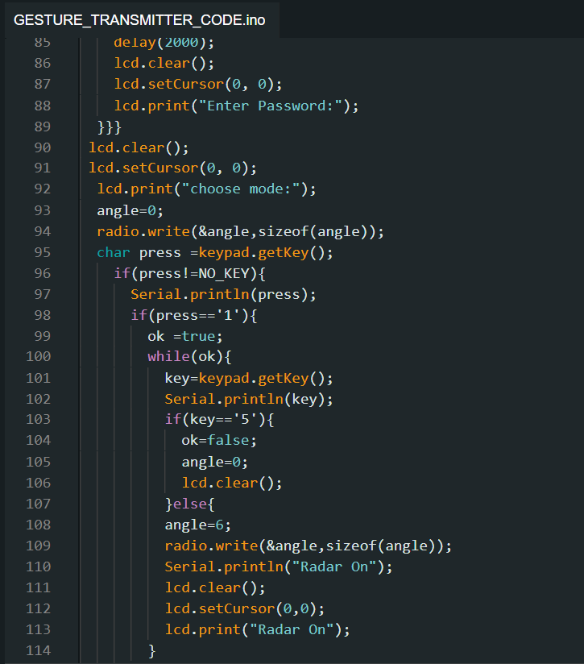
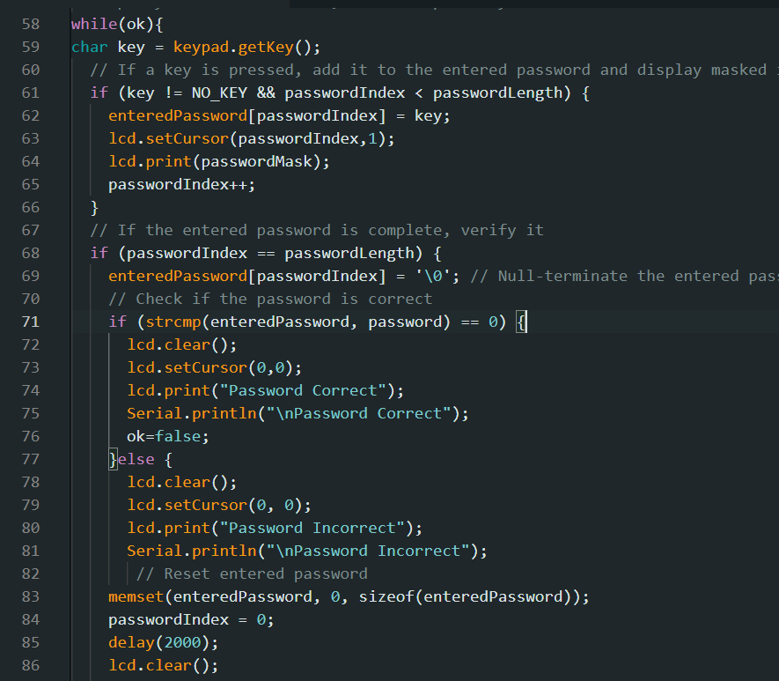
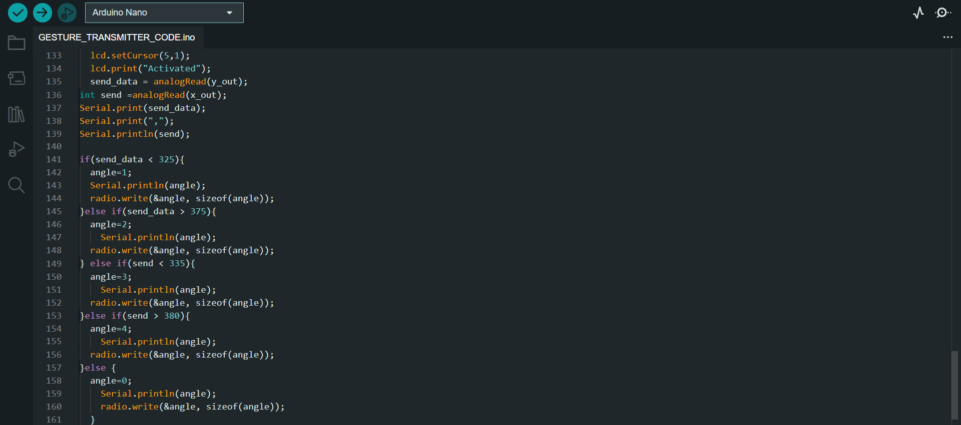
1. Arduino
1. Arduino
3. Andriod studio
4. Flutter application
6. FireBase
2. TinkerCad
5. Web application

Slide 26
2. TinkerCad

Slide 27
2. TinkerCad
3. Android Studio

Slide 28


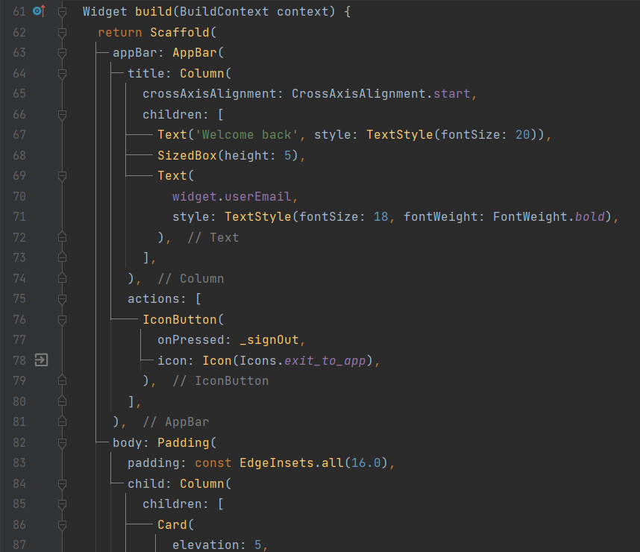
3. Android Studio
4. Flutter Application

Slide 29
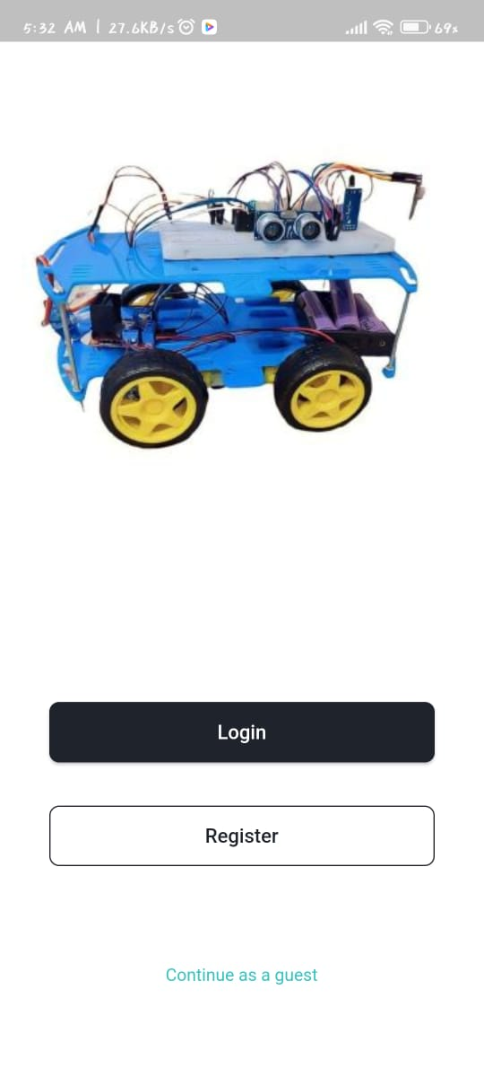


4. Flutter Application
5. Web Application

Slide 30


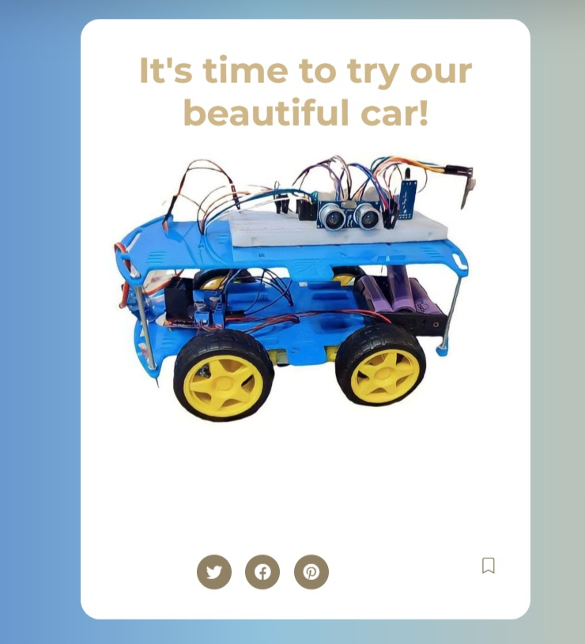
5. Web Application
6. Fire Base

Slide 31
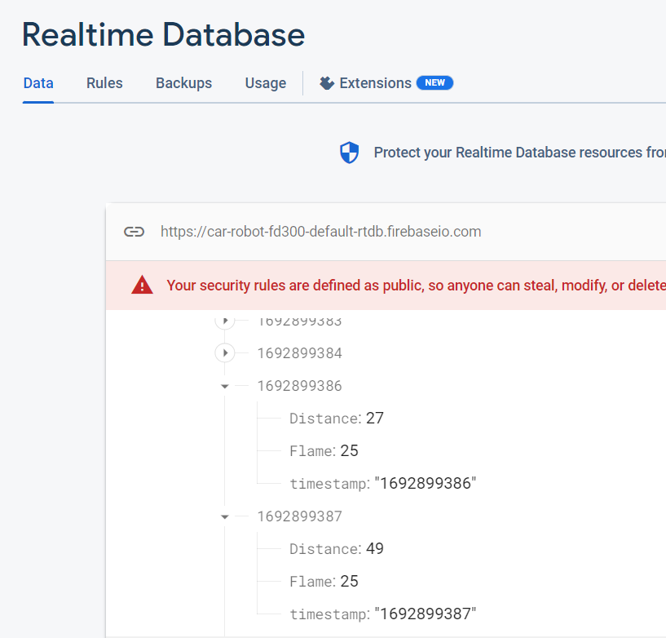
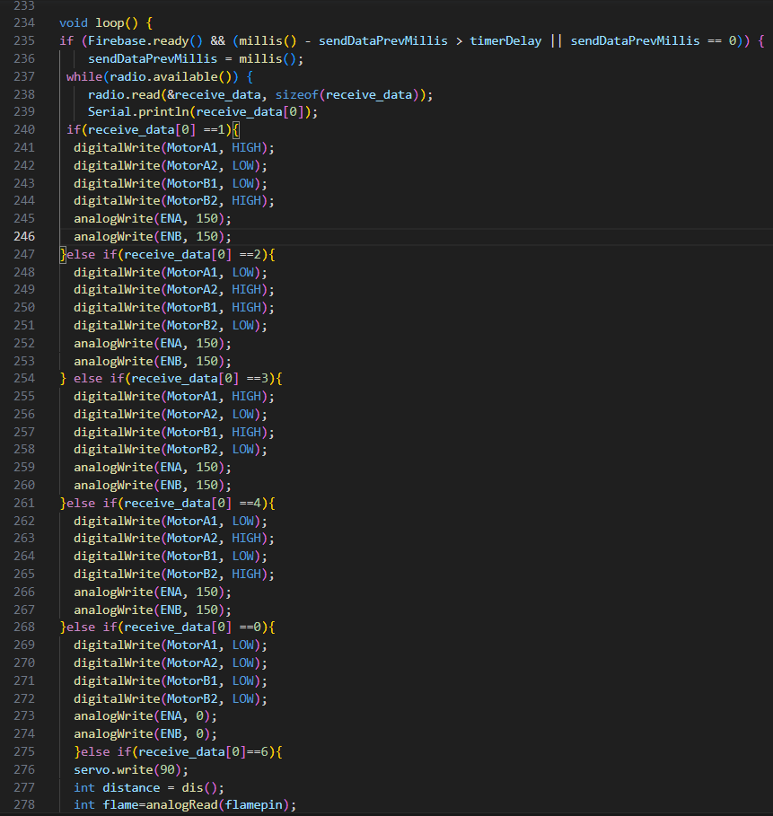
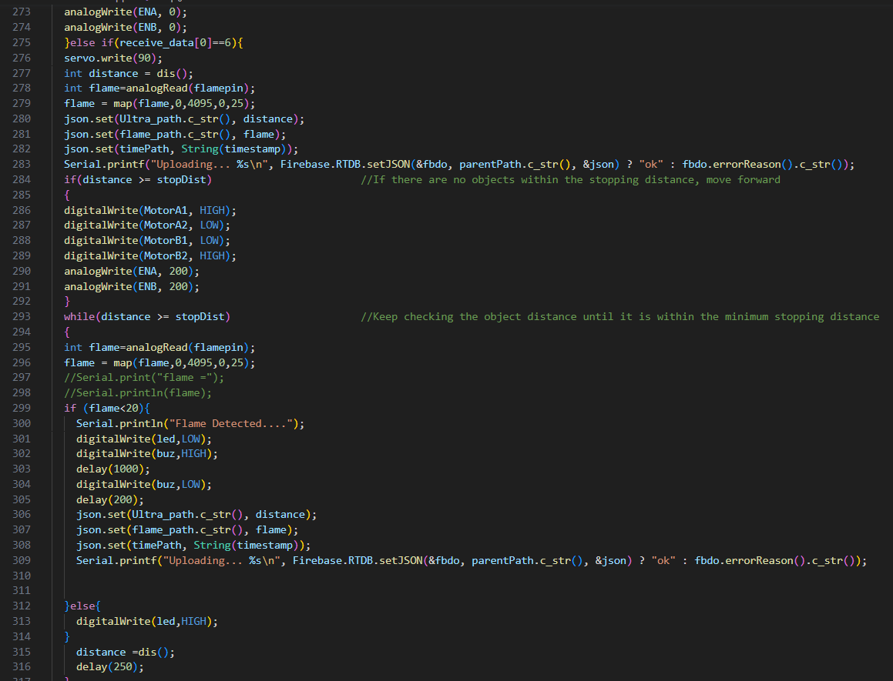
6. Fire Base

Slide 32
6. Fire Base

Slide 33






Our team
Abdelrahman Mohamed
Shahd Khalaf
Mahmoud Nour
Menna Yasser
Omar Mohamed
Aya Nabil

Slide 34
Thank you!

